Slide 1
assignment
File created on: 28/7/2024 10:56:08 pm HKT

Slide 2
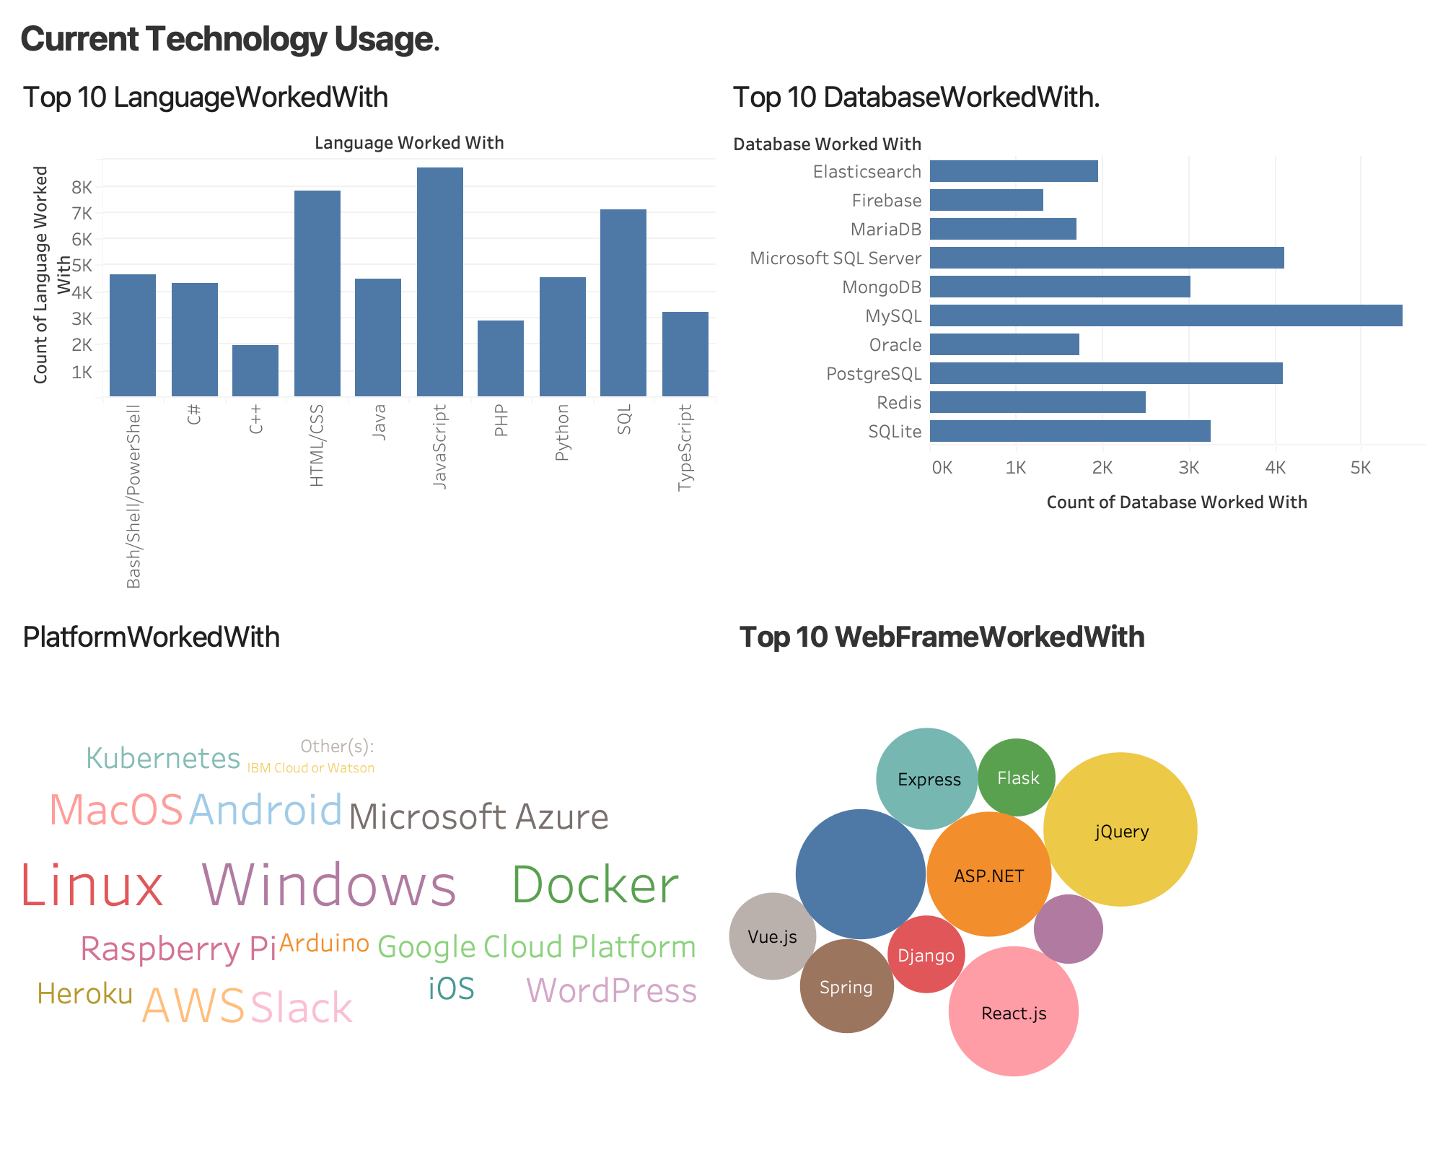

Slide 3
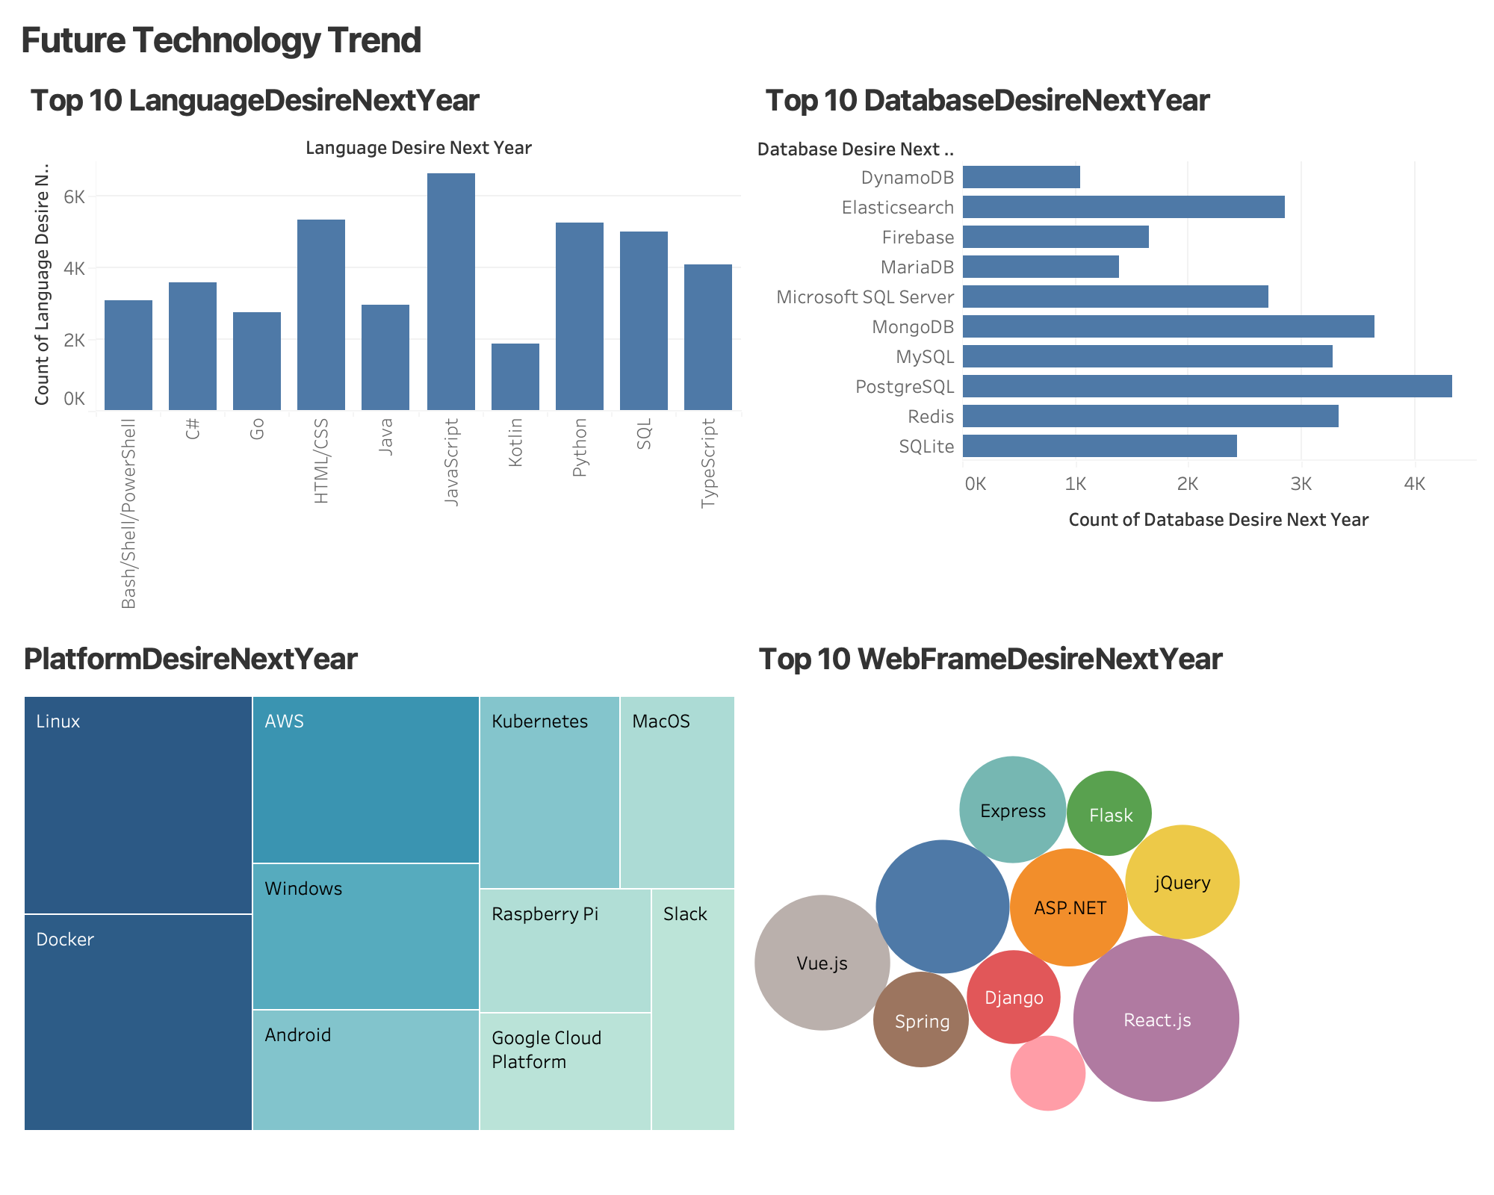

Slide 4
